Slide 1
DIRECT MEMORY ACCESS [DMA]

Slide 2
What is DMA?
🠶 In Direct Memory access CPU is idle and peripheral devices
manages the memory buses directly
🠶 DMA controller takes over the buses to manage the transfer directly between I/O devices and memory
🠶 DMA transfer is done in 2 ways
🠶 Burst Transfer: a block of memory words is transferred in continuous burst at a time . Used in fast devices like magnetic disk
🠶 Cycle stealing: DMA controller transfers one data word at a time .After which it return control of the buses to CPU

Slide 3
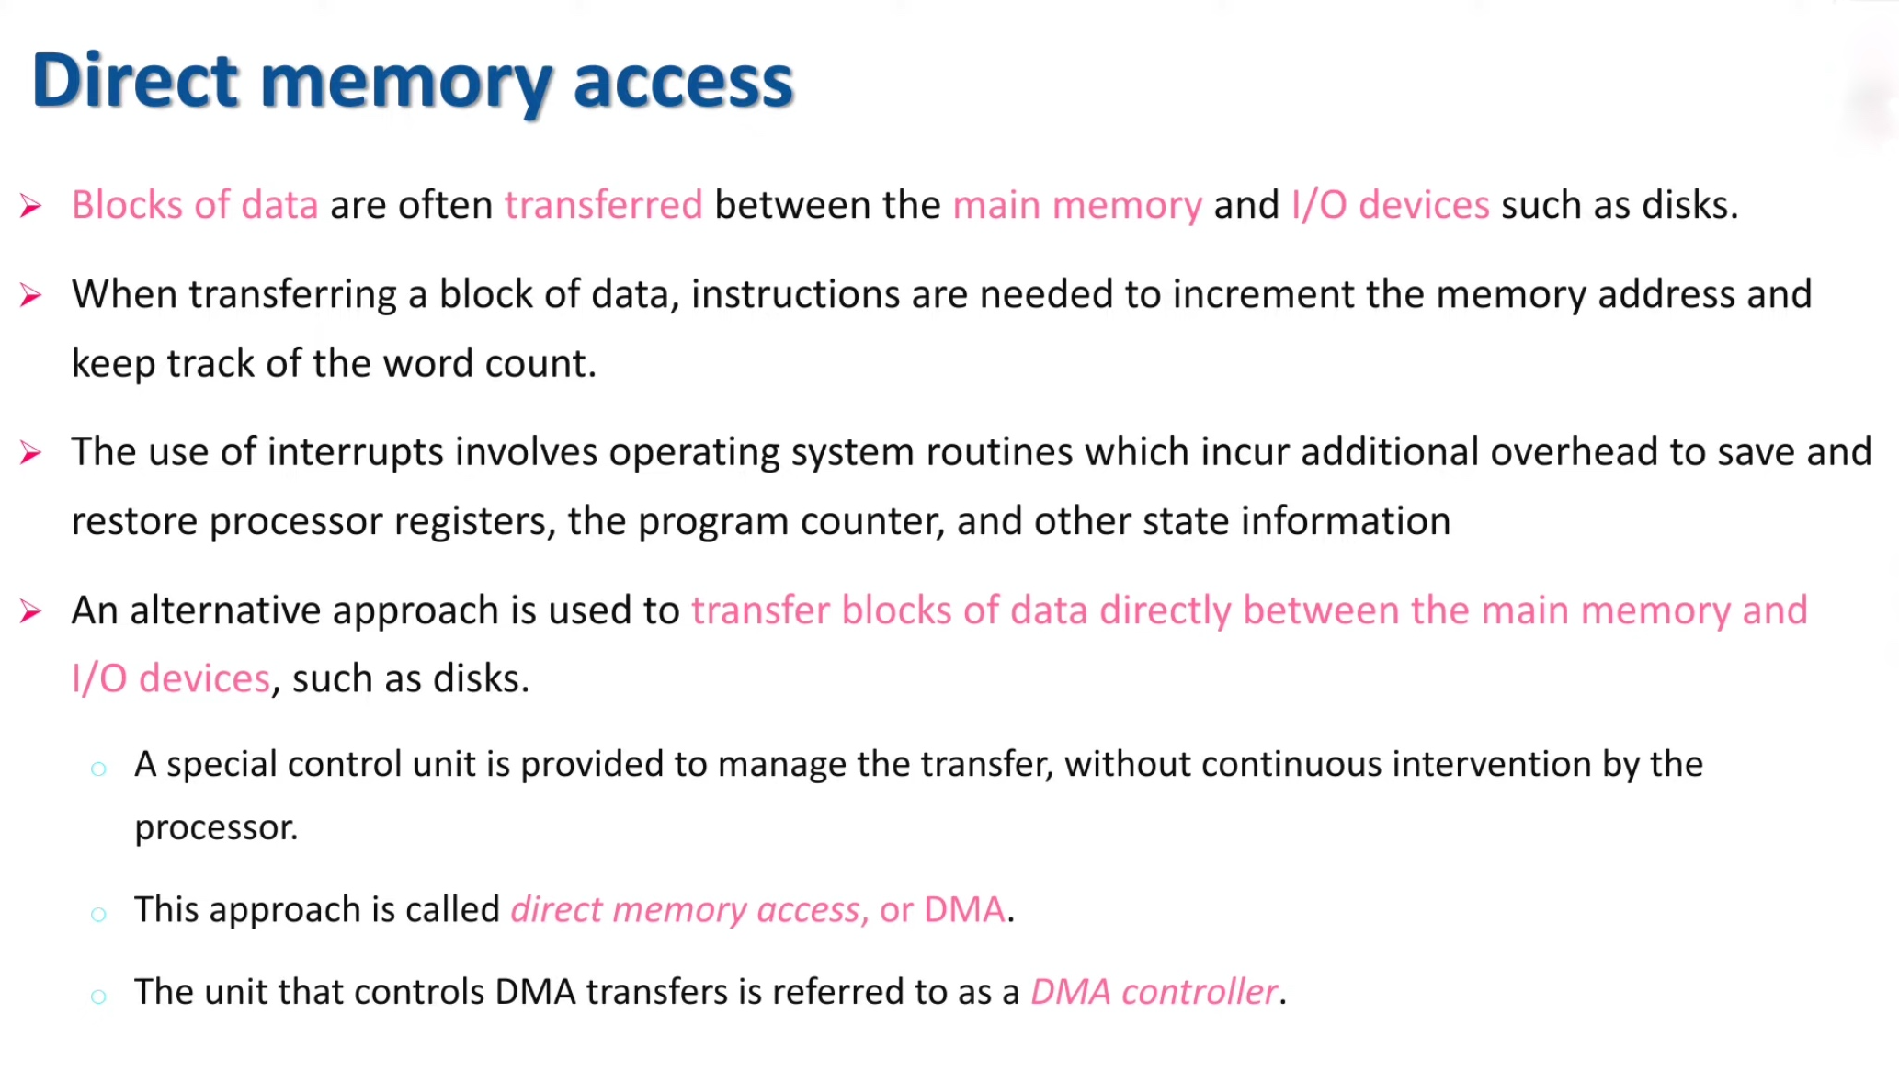

Slide 4
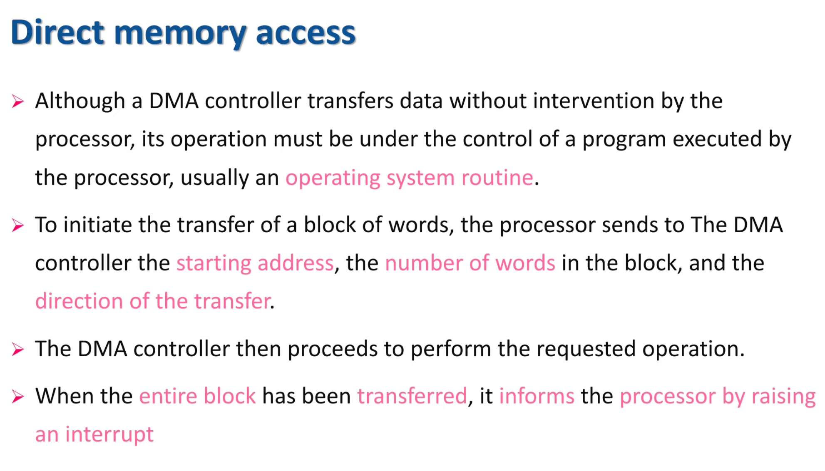

Slide 5
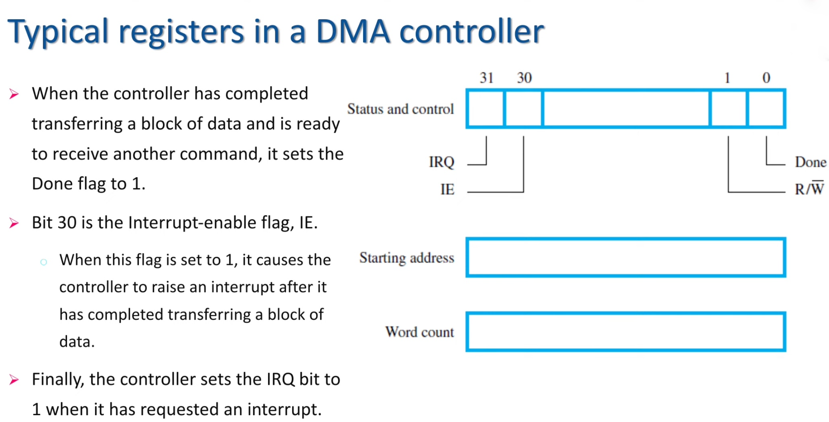

Slide 6
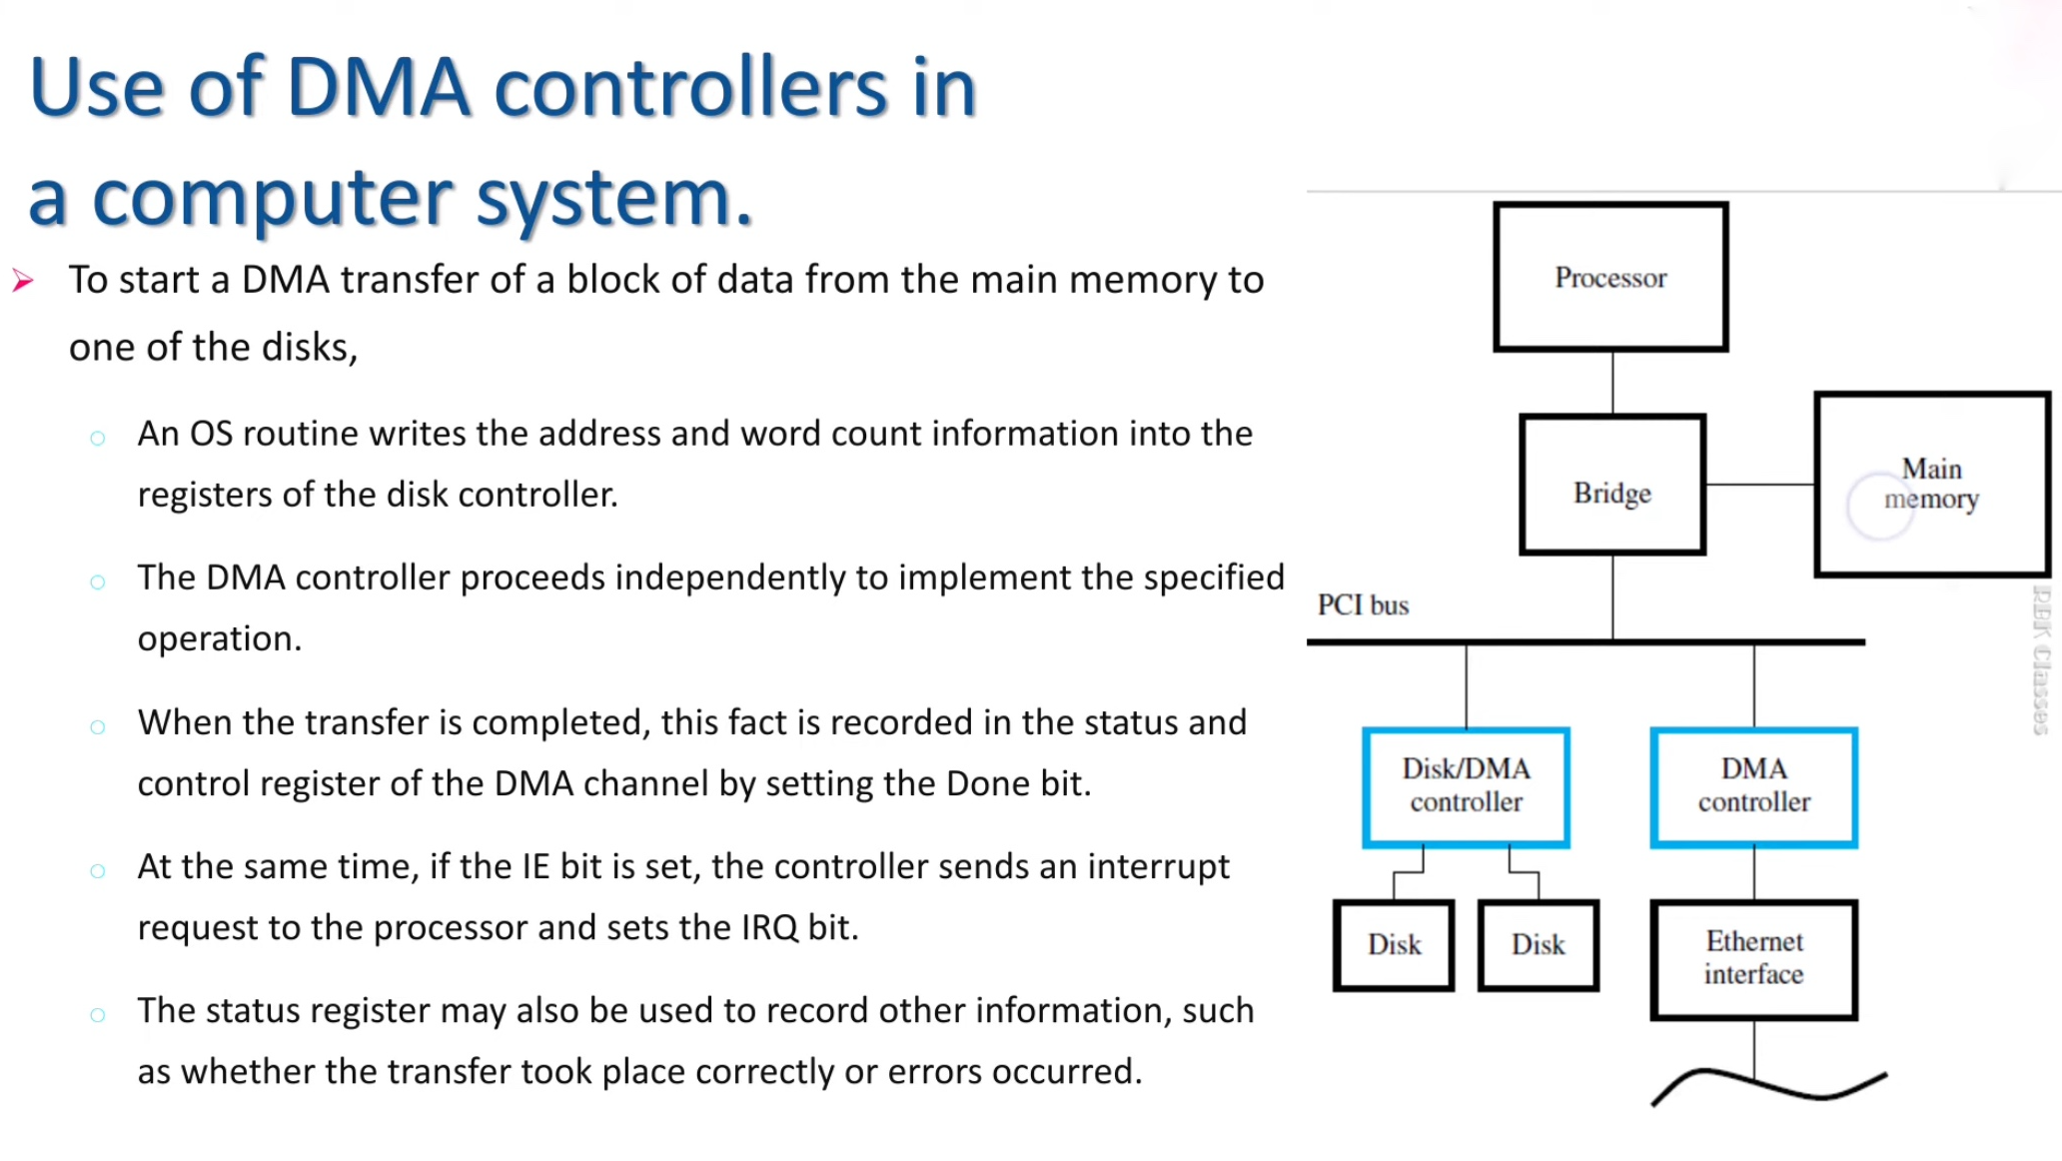

Slide 7
Working of DMA
DBUS
Address bus
BR
BR
ABUS
Data bus
High-impedance (disable)
when BG is enabled
DMA
Controller
Bus request
CPU
RD
Read
BG
BG
Bus grant
WR
Write
🠶 DMA controller uses the Bus Request(BR) input to request the CPU to relinquish the control of the buses
🠶 Then CPU terminates the execution of current instruction and places the address bus, Data bus, read and write lines into a high impedance state(like open circuit)
🠶 CPU activates Bus Grant (BG) signal to inform the DMA that buses are available
🠶 DMA takes control of buses and perform memory transfer
🠶 When DMA terminates it disable BR signal CPU disables BG signal and returns to it normal operation

Slide 8
DMA Controller
🠶 DMA controller has 3 registers
🠶 Address Register: Contains the address to specify desired location
🠶 Word Count Register: Specifies the number of words that must be transferred
🠶Control Register: Specify mode of transfer
Registers are selected by the CPU by enabling DMA select and register select input
🠶 When BG=0 CPU is communicating with registers.
🠶 When BG=1 DMA is communicating with memory
Address bus
Data bus
Data bus buffers
Address bus buffers
CS
Internal bus
Address register
DMA select
Register select
RS
Read
RD
Word count register
Write
WR
Control logic
Bus request
BR
Control register
Bus grant Interrupt
BG
Interrupt
DMA request
DMA Acknowledge
to I/O device

Slide 9
DMA transfer
🠶I/O Device sends a DMA request
🠶DMAC activates the BR line
🠶 CPU responds with BG line
🠶DMAC sends a DMA acknowledge to the I/O device
🠶I/O device puts a word in the data bus (I/o memory write) or receives a word from data bus(For memory read)
🠶 DMAC write a data to the address specified by Address register . Increment address register
Interrupt
BG
CPU
Random access memory (RAM)
BR
RD WR Address Data RD WR Address Data Read control
Write control Data bus Address bus
Address select
RD DS
WR
Address Data
DMA acknowledge
RS
BR BG
Interrupt
Direct memory access (DAM) controller
I/O Peripheral device
DMA request

Slide 10
DMA transfer
🠶Word count register ≠ 0 DMAC checks the
DMA request from I/O device .If there is no request DMA disables BR line So that CPU continues to execute its own program
🠶When peripherals request another transfer, DMA requests buses again.
🠶Word count register = 0 DMA stops frurther transfer and removes BR .It inform CPU
Interrupt
BG
CPU
Random access memory (RAM)
BR
RD WR Address Data RD WR Address Data Read control
Write control Data bus Address bus
Address select
RD DS
through EOT interrupt
WR
Address Data
DMA acknowledge
RS
BR
Direct memory access (DAM) controller
I/O Peripheral device
BG
Interrupt
DMA request

